Slide 1
IBM University Engagement Project Submission
“Exploring the Power of Agentic AI with IBM Granite and LangFlow”

Slide 2

Project Tile – Intelligent Shopping Agent
Domain of Project – E-Commerce
Student Name | Recent Passport Photo | Email ID | Mobile number [WhatsApp]
Nakshatra Kodam |  | nakshatrakodam09@gmail.com | 8855897796
Recommended font style and size: Font Style: Arial Font Size (Heading): 28
Font Size (Content): 20

Slide 3
Problem Statement -
Problem Statement : Intelligent Shopping Agent
The Challenge
Shoppers today face an overload of product options, scattered reviews, and dynamic pricing across e-commerce platforms. Finding the right product that balances price, quality, and personal preferences is time-consuming and frustrating. Traditional recommendation systems often fail to capture real-time trends, personalized needs, or contextual factors like urgency, budget, or sustainability. The challenge is not just to recommend products but to act as a smart shopping companion that helps buyers make informed and confident decisions.
The Objective
Build an agentic AI shopping assistant that provides intelligent, personalized, and real-time support.
The solution should:
Fuse Multisource Data: Aggregate product details, reviews, ratings, and price comparisons across multiple e-commerce sites into unified insights.
Enable Multimodal Search: Allow users to input voice queries, images (e.g., a photo of a product), or text descriptions to find best-matching products.
Create a Predictive & Agentic Layer: Suggest purchase timing (e.g., discounts, seasonal offers), recommend alternatives, and alert users about price drops or fake reviews.
Visualize Smart Shopping Pulse: Provide a dashboard summarizing comparisons, sustainability scores, trending products, and personalized shopping lists.

Slide 4
Proposed Solution -
We propose ShopWise AI, an AI-powered Agentic Shopping Assistant built using IBM Langflow/IBM Orchestrate and IBM Foundation Models to deliver personalized, data-driven shopping recommendations. The solution aggregates product details, reviews, ratings, prices, and availability from multiple trusted sources, providing users with a unified view for easy comparison.
The agent understands user preferences such as budget, preferred brands, product category, and shopping intent to recommend the most suitable products. It also supports multimodal search through text, voice, and images, enabling users to identify products, discover similar alternatives, and compare options effortlessly.
Additionally, ShopWise AI leverages AI-driven insights to analyze customer reviews, identify key product strengths and weaknesses, detect potentially fake reviews, and recommend products that offer the best balance between price, quality, and performance. It also provides real-time price comparisons, suggests suitable alternatives when products are unavailable or exceed the user's budget, and helps users make cost-effective purchasing decisions.
To further enhance the shopping experience, the assistant generates personalized shopping lists, recommends complementary products, and offers predictive shopping insights, such as the best time to purchase based on seasonal discounts and price trends. An interactive dashboard presents product comparisons, sustainability scores, trending products, and personalized recommendations in an intuitive format, enabling users to shop smarter, faster, and with greater confidence.

Slide 5
Technology Used
Langflow platform -For designing and orchestrating multi-agent workflows visually
IBM Granite model - for eg – ibm-granite-3-2-8b – For natural language understanding, reasoning, and personalization
IBM Cloud – It provides the infrastructure to build, deploy, and scale the Nutrition Agent efficiently. IBM Cloud enables a reliable, secure, and scalable environment for deploying the Nutrition Agent.
RAG– RAG to fetch real data first, then generate intelligent answers, making the Nutrition Agent more trustworthy and effective.
IBM Watsonx.ai - For model deployment, embeddings, and AI governance
Vector Database (FAISS/Chroma) – For RAG-based nutritional data retrieval

Slide 6
Langflow component Used -
1) Chat Input – Interface where users enter their queries, preferences, or meal details (text/voice/image).
2) IBM watsonx AI Agent - Processes user input using Granite models to generate personalized nutrition insights and recommendations.
3) Name of IBM Granite model - Granite-4.0-8B-Instruct → Fast, efficient for real-time diet recommendations
4) Chat output -Displays AI-generated responses such as diet plans, nutritional analysis, and health suggestions.
5) File component - Stores and retrieves user data, meal logs, and nutritional datasets for analysis and tracking.
6) Add name of any other component used.

Slide 7
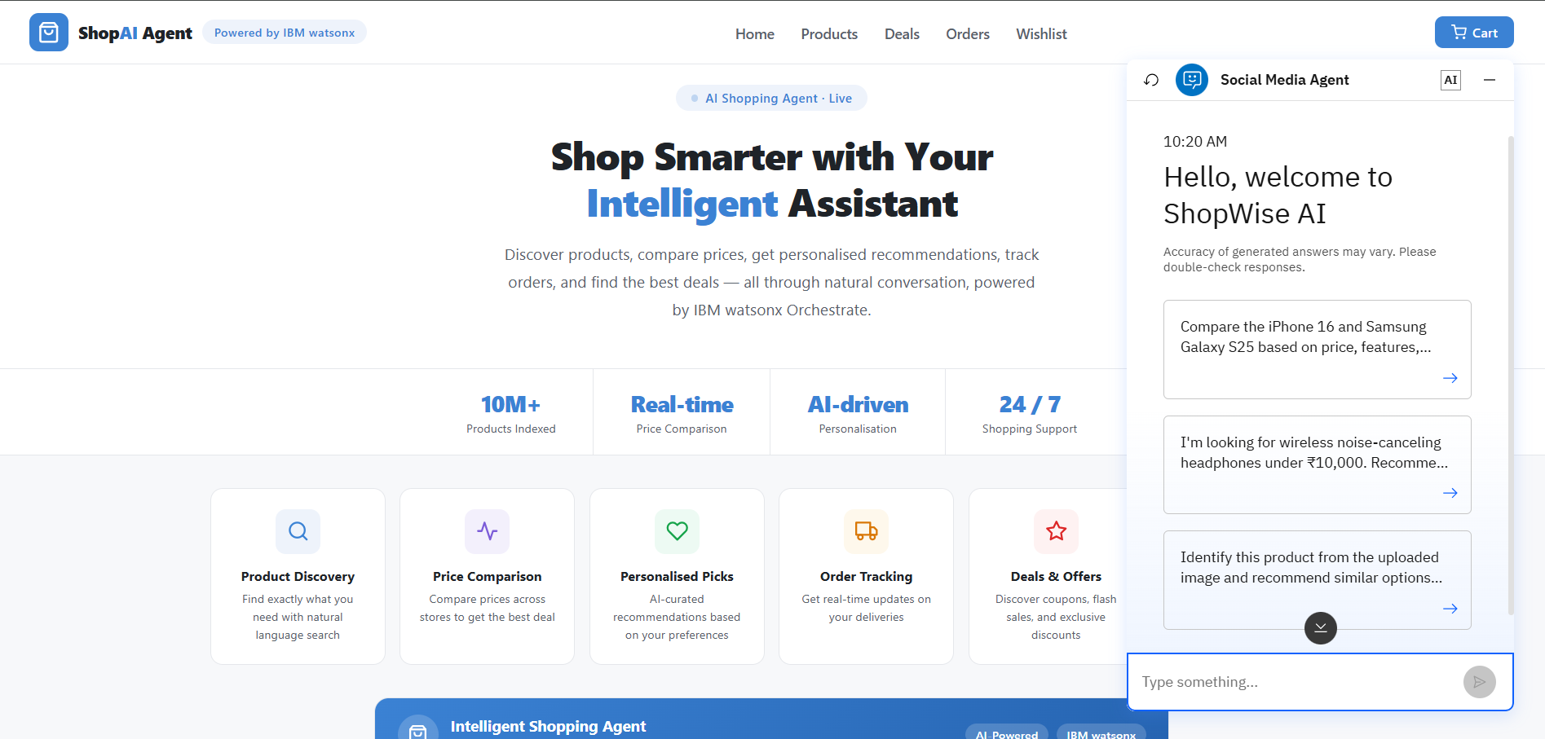
Langflow workflow -

Slide 8
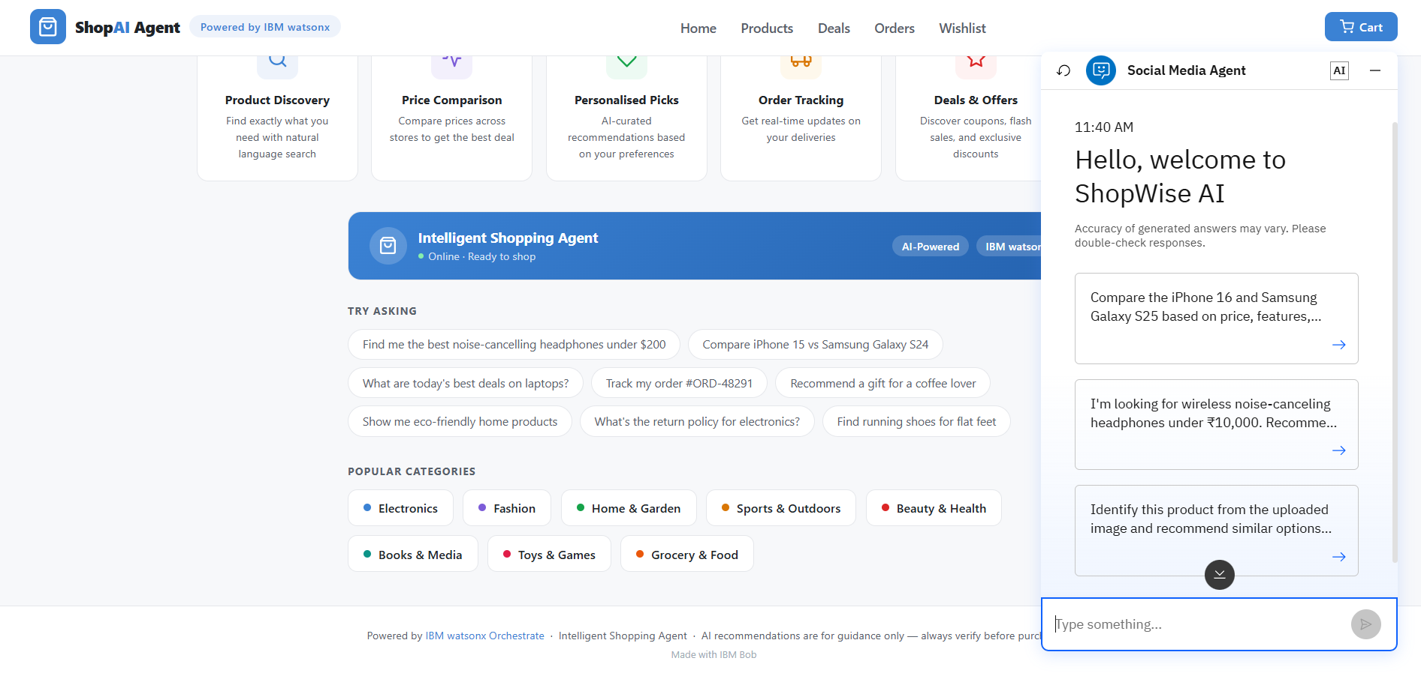
Architecture blueprint

Slide 9

Role of Agentic AI in the solution
Role of Agentic AI in Nutrition Agent
Agentic AI enables the Nutrition Agent to function as an intelligent, autonomous system rather than a simple chatbot. Using IBM watsonx.ai and IBM Granite models, it coordinates multiple specialized agents to deliver personalized nutrition guidance.
Each agent performs a specific role—such as retrieving nutritional data, generating diet plans, providing health advice, and analyzing food logs—while working collaboratively. This multi-agent approach ensures efficient task execution and accurate results.
Agentic AI also brings context awareness, understanding user details like age, health conditions, and fitness goals to generate tailored recommendations. It supports real-time adaptation, continuously updating suggestions based on user inputs like daily meals.
Additionally, agents communicate with each other, enabling better decision-making and improved outcomes.
Overall, Agentic AI makes the system proactive, personalized, and goal-driven, acting like a smart digital nutritionist that helps users maintain a healthy lifestyle.

Slide 10


Token Usage
11,761 token are used
Before Prompt
After the Prompt
·
·
·

Slide 11
Novelty and Uniqueness
Agentic AI Shopping Companion: Unlike traditional recommendation systems, ShopWise AI acts as an intelligent shopping companion that understands user intent, reasons through multiple options, and provides personalized purchase guidance.
Unified Multi-Source Intelligence: The agent aggregates product details, prices, ratings, reviews, and seller information from multiple trusted sources, eliminating the need for users to manually compare products across different platforms.
Multimodal Product Discovery: Users can search for products using text, voice, or images, making product discovery faster, more intuitive, and accessible.
Predictive Shopping Insights: Beyond recommendations, the agent analyzes price trends, seasonal discounts, and market patterns to suggest the optimal time to purchase and maximize savings.
Trust & Transparency: The solution detects potentially fake reviews, highlights review sentiment, and clearly explains why a product is recommended, helping users make informed decisions.
Personalized & Sustainable Recommendations: ShopWise AI tailors recommendations based on budget, preferences, shopping intent, and sustainability goals, while also suggesting eco-friendly alternatives. Interactive Shopping Dashboard: A centralized dashboard provides product comparisons, price analysis, sustainability scores, trending products, and personalized shopping lists, delivering all essential shopping insights in one place.
IBM-Powered Agentic Workflow: Built with IBM Langflow/IBM Orchestrate and IBM Foundation Models, the solution combines RAG, AI reasoning, and orchestration to deliver accurate, explainable, and context-aware shopping assistance.

Slide 12
Git Hub Link
Please create public github repository (Enable Add README button while creating repository) with format –
Please test and Paste the working Github URL – https://github.com/Nakshatrak23/ShopWise-AI
Make sure you have Uploaded following three files into your github repository 1) app.json file , 2) yourproblemstatement.pdf file 3) your projectpresntation.pptx file 4)any other files
·
·
·

Slide 13
Future Scope
AI Price Prediction: Enhance the agent with advanced machine learning models to accurately predict future price drops, seasonal discounts, and the best time to purchase products.
Cross-Platform Purchase Integration: Enable direct integration with multiple e-commerce platforms, allowing users to compare products, add items to carts, and complete purchases from a single interface.
Personalized Shopping Memory: Build long-term user profiles to learn shopping habits, favorite brands, preferred price ranges, and past purchases for even more personalized recommendations. AR-Based Product Visualization: Integrate Augmented Reality (AR) to let users virtually try products such as furniture, home décor, eyewear, or apparel before purchasing.
Smart Notifications: Provide real-time alerts for price drops, stock availability, flash sales, warranty expirations, and personalized promotional offers.
Enhanced Sustainability Insights: Expand sustainability analysis by including carbon footprint estimates, ethical sourcing information, recyclable packaging, and eco-friendly product comparisons.
·
·
·

Slide 14

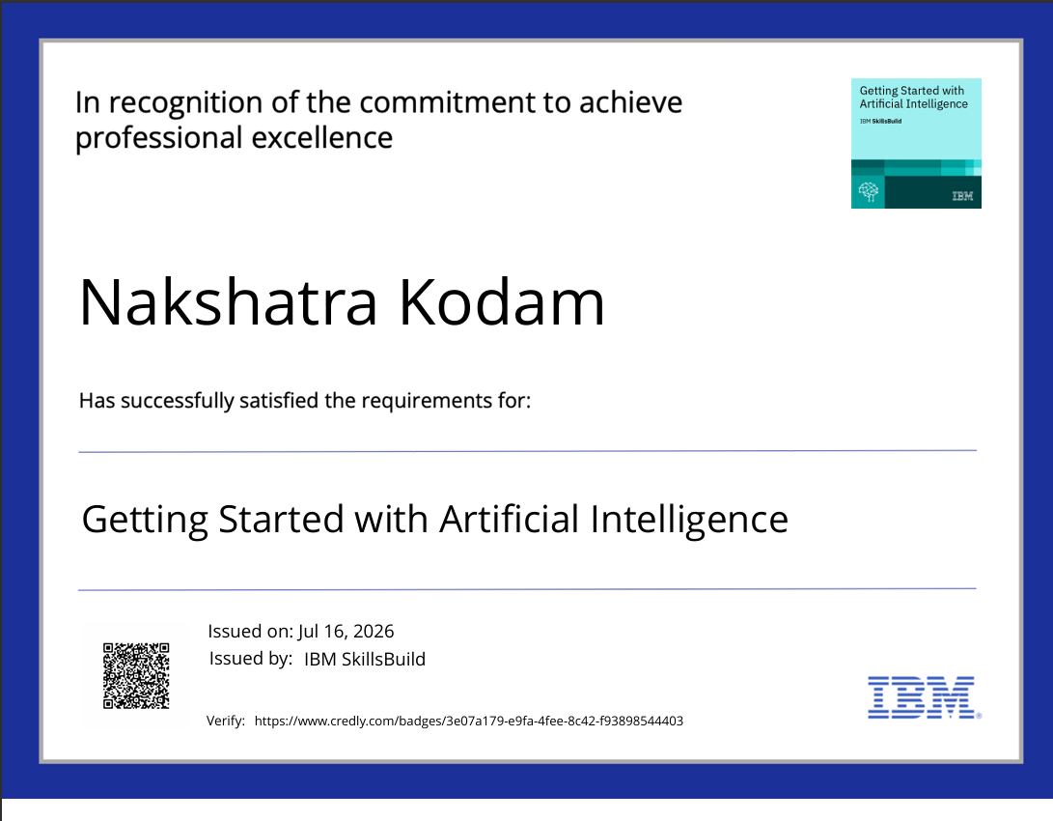
Certificates Earned:
Please add your credly certificate

Slide 15
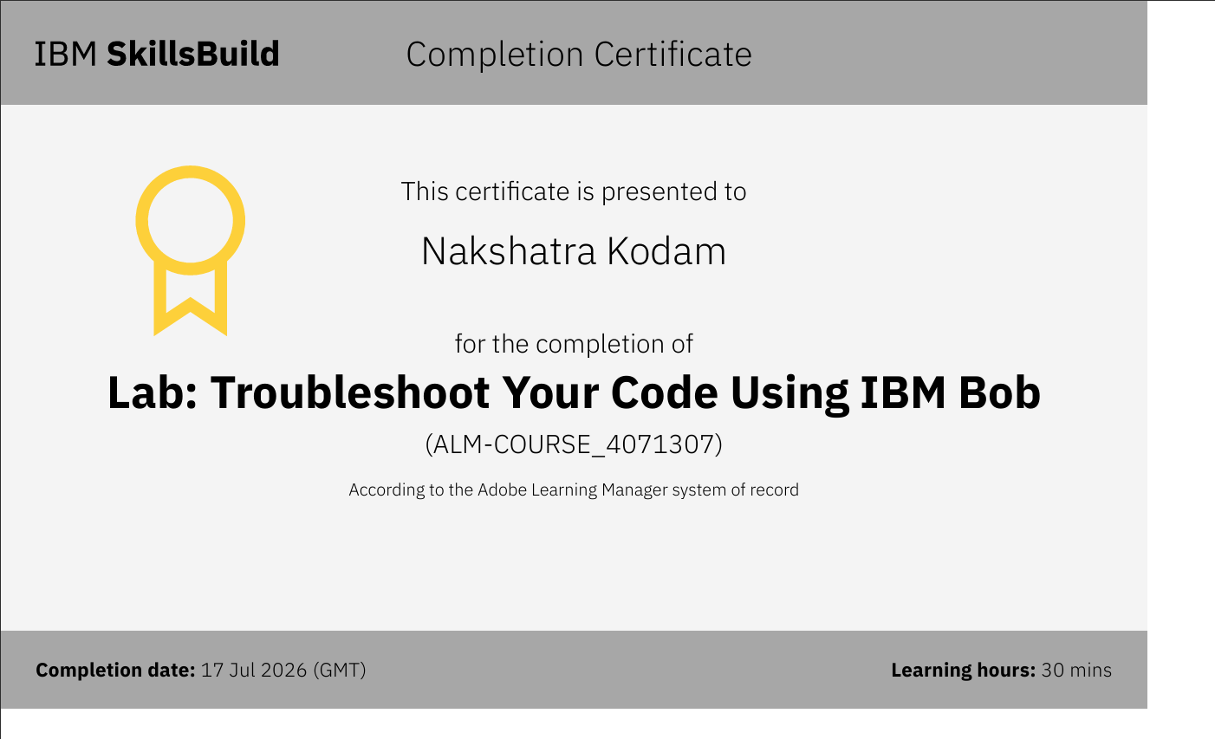
Certificates Earned:​
Add your IBM BOB Certificate

Slide 16


